Slide 1


EDA CAPSTONE PROECT -01
EDA ON AIRBUB NYC
ARTISTIC ALGORITHM :
PRESENTED BY –
AMIT KUMAR SINGH
(SELF)
Githud id; amitsingh.as595@gmail.com

Slide 2

ABSTRACT :
Purpose –The purpose of this paper is to review the extant literature on Airbnb one of the most signiﬁcant recent innovations in the tourism sector –to assess the research progress that has been accomplished to date.
Design/methodology/approach –Numerous journal databases were searched, and 132 peer-reviewed journal articles from various disciplines were reviewed. Key attributes of each paper were recorded, and a content analysis was undertaken.
Findings –A survey of the literature found that the majority of Airbnb research has been published quite recently, often in hospitality/tourism journals, and the research has been conducted primarily by researchers in the USA/Canada and Europe.
.Originality/value –This is the ﬁrst paper to review the extant literature speciﬁcally about Airbnb.

Slide 3
INTRODUCTION :
Airbnb, as in “Air Bed and Breakfast,” is a service that lets property owners rent out their spaces to travelers looking for a place to stay. Travelers can rent a space for multiple people to share, a shared space with private rooms, or the entire property for themselves.
Since2008 , guests and hosts have used Airbnb to expand on traveling Possibilities and present a more unique, personalized way of experiencing the world.
Now a days ,Airbub They set up air mattresses in the apartment’s living room for guests to sleep on and cooked homemade breakfast in the morning.
Since then, Airbnb has become one of the trailblazers of peer-to-peer business modal .The modal also gives you opportunity to tends to be more profitable for sectors.

Slide 4
METHODS
General characteristics of Airbnb Project :
Since 2008, guests and hosts have used Airbnb to expand on traveling possibilities and present a more unique, personalized way of experiencing the world. Today, Airbnb became one of a kind service that is used and recognized by the whole world. Data analysis on millions of listings provided through Airbnb is a crucial factor for the company. These millions of listings generate a lot of data - data that can be analyzed and used for security, business decisions, understanding of customers' and providers' (hosts) behavior and performance on the platform, guiding marketing initiatives, implementation of innovative additional services and much more
This dataset has around 49,000 observations in it with 16 columns and it is a mix between categorical and numeric values.

Slide 5
UNDERSTANDING OF DATA :
ID
NAME
HOST_ID
HOST_NAME
NEIIGHBOURHOOD_GROUP
NEIGHBOURHOOD
LATITUDE
LONGITUDE
ROOM_TYPE
PRICE
MINIMUM_NIGHTS
NUMBER_OF_REVIEWS
LAST_REVIEW
REVIEWS_PER_MONTHS
CALCULATED_HOST_LISTING_COUNT
AVAILABILTY_365_NUMBER #df.describe()

Slide 6
EXPLORE AND ANALYZE THE DATA
Agenda:
Explore and analyze the data to discover key understandings (not limited to these) such as :
What can we learn about different hosts and areas?
What can we learn from predictions? (ex: locations, prices, reviews, etc)
Which hosts are the busiest and why?
Is there any noticeable difference of traffic among different areas and what could be the reason for it?

Slide 7
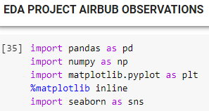
IMPORT LIBRARIES
LOAD THE DATA
The dataset we use is “NEW YORK AIRBNB”.By using Pandas library

Slide 8
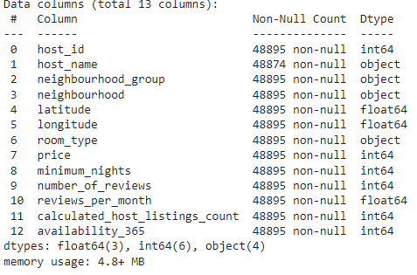
Drop unnecessary columns

Slide 9
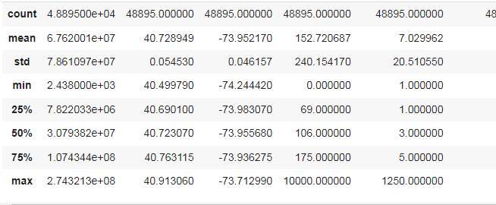
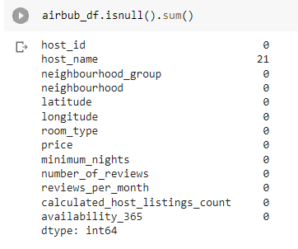
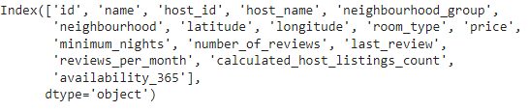
DATA PROFILING AND CLEANSING

Slide 10
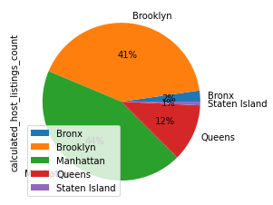
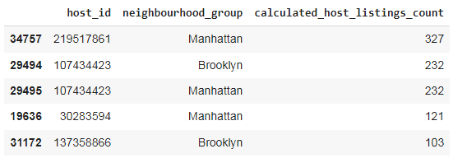
EXPLORATION DATA AND VISUALIZATION
What can we learn about different hosts and areas?
The pie chart shows that airbnb listing in newyork are MANHATTAN, and BROOKLYN has the heighest share of hotels .

Slide 11
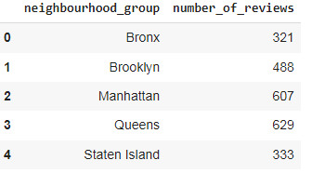
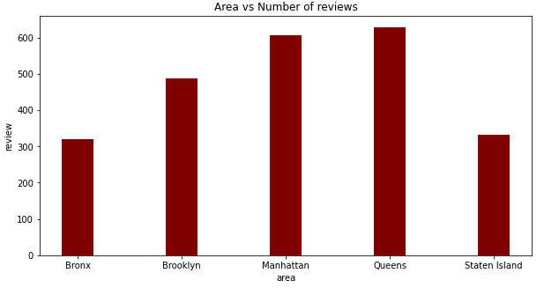
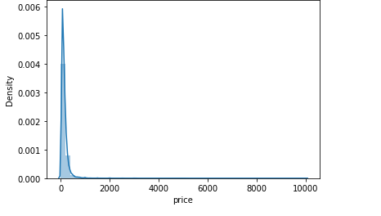
What can we learn from predictions? (ex: locations, prices, reviews, etc)

Slide 12
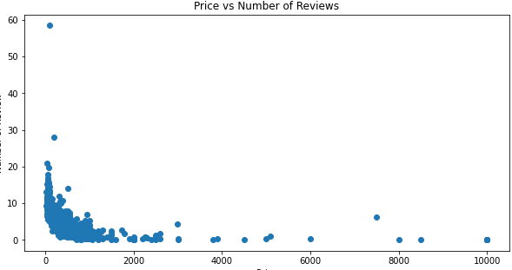

Slide 13
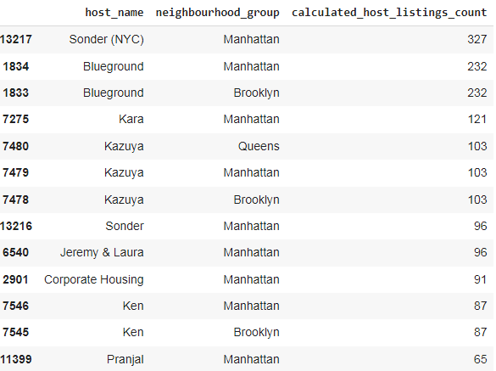
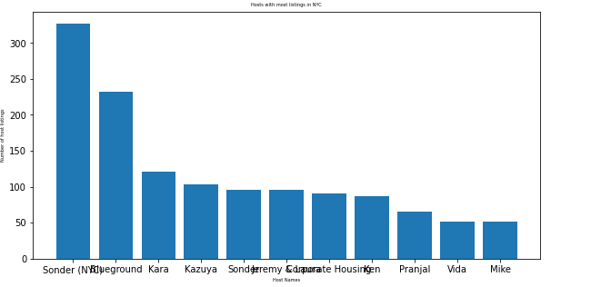
3.Which hosts are the busiest and why?
NTENTS :

Slide 14
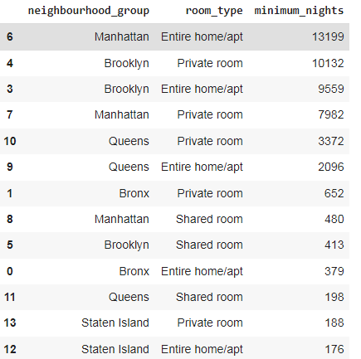
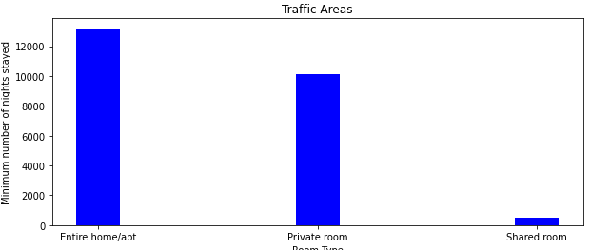
Is there any noticeable difference of traffic among different areas and what could be the reason for it?

Slide 15
Conclusion:
The people who prefer to stay in Entire home or Apartment they are going to stay bit longer in that particular Neighborhood only.
The people who prefer to stay in Private room they won't stay longer as compared to Home or Apartment.
Most people prefer to pay less price.
If there are more number of Reviews for particular Neighborhood group that means that place is a tourist place.
If people are not staying more then one night means they

Slide 16
THANK YOU

